Slide 1
Engineering Physics Laboratory
(Course Code : PHY119)
Experiment Number: 5
AIM: Determination of the velocity of Ultrasonic waves using Ultrasonic interferometer. Hence find the compressibility of the given liquid.

Slide 2
Learning Objectives
To understand about standing waves in liquid column.
b. To perform the simulated version of the actual ultrasonic interferometer experiment.
c. To enhance the knowledge of production of ultrasonic waves.
d. To understand the dependence of the velocity of ultrasonic waves on the density of the medium.

Slide 3
Pre-requisite Understanding

Slide 4
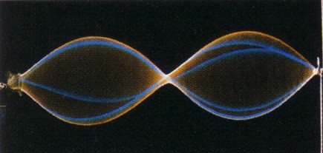
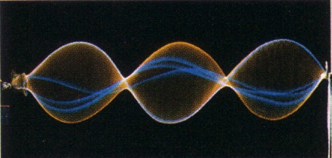
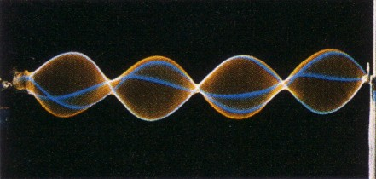
Standing waves
and resonance
At ordinary frequencies, waves travel backwards and forwards along the string or any media/vacuum.
Each new reflected wave has a new phase.

Slide 5
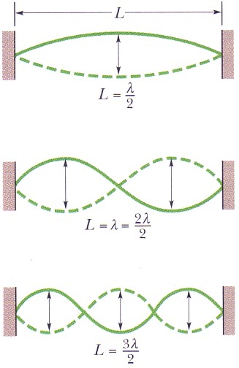
Standing waves and resonance
However, at certain special frequencies, the interference produces strong standing wave patterns.
Such a standing wave is said to be produced at resonance.
These certain frequencies are called resonant frequencies.

Slide 6
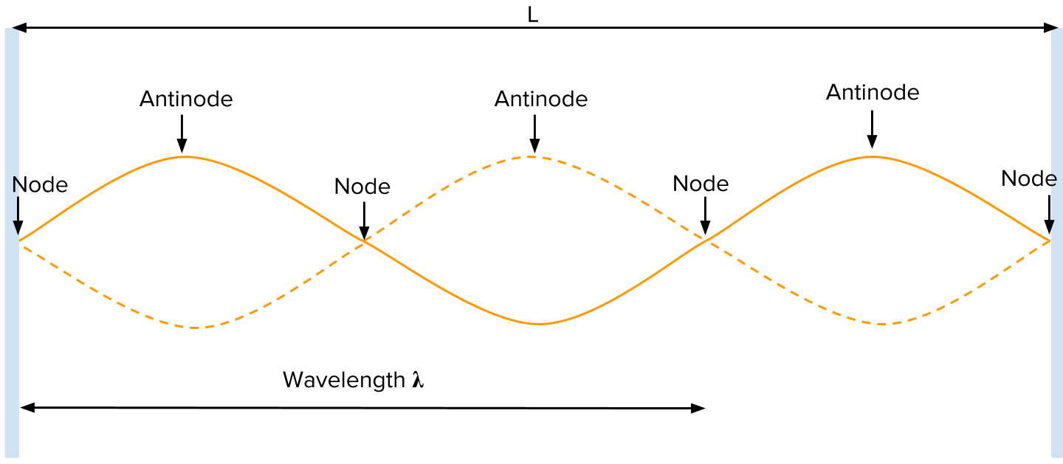
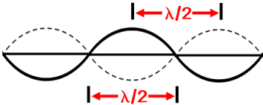
Node and anti-node in a standing wave
Anti-node: Region of maximum amplitude in a standing wave
Node: Region of minimum amplitude in a standing wave

Slide 7
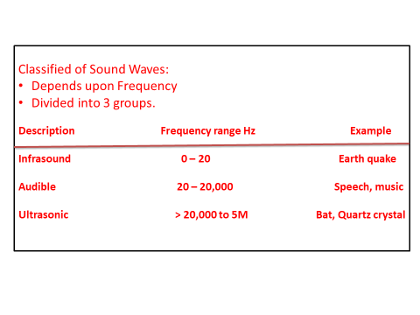

Slide 8
Production of ultrasonic waves by inverse Piezo-electric effect
Principle : Inverse piezo electric effect
If mechanical pressure is applied to one pair of opposite faces of certain crystals like quartz, equal and opposite electrical charges appear across its other faces. This is called as piezo-electric effect.
The converse of piezo electric effect is also true.
If an electric field is applied to one pair of faces, the corresponding changes in the dimensions of the other pair of faces of the crystal are produced. This is known as inverse piezo electric effect or electrostriction.

Slide 9
Step by Step guide to perform the experiment in Virtual lab
(1) Follow the slides below.
(2) Click on the YouTube video link: http://www.youtube.com/v/MD_zkNzF3eA&hl=en&fs=1&rel=0&hd=1&autoplay=1

Slide 10
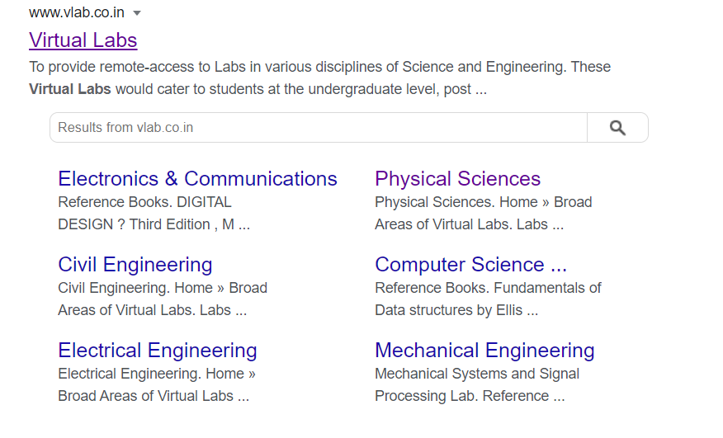
Type this link on the address bar or Click on this link : https://www.vlab.co.in/

Slide 11
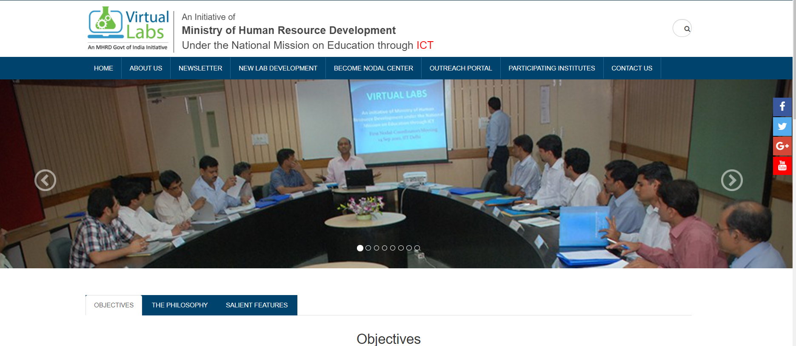
This page will open. Scroll down the page end click on Physical sciences

Slide 12

Scroll down the page end click on Physical sciences

Slide 13
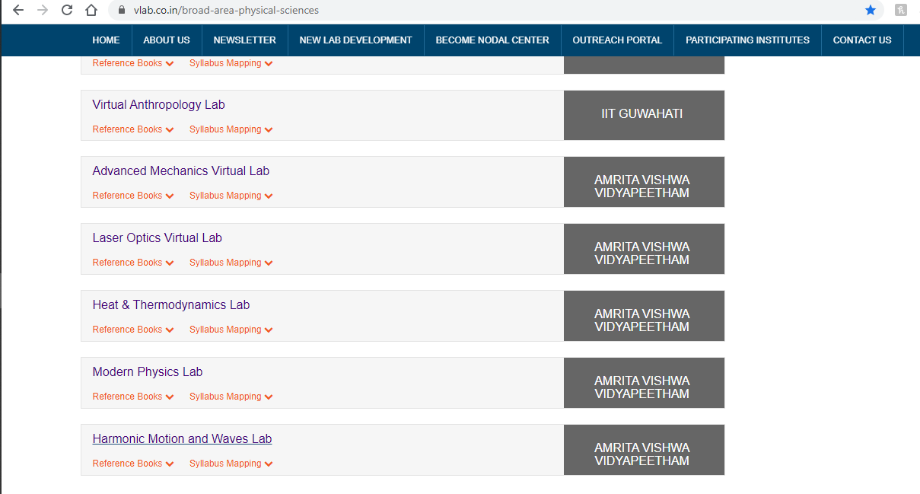
Then click on – Harmonic motion and waves lab

Slide 14
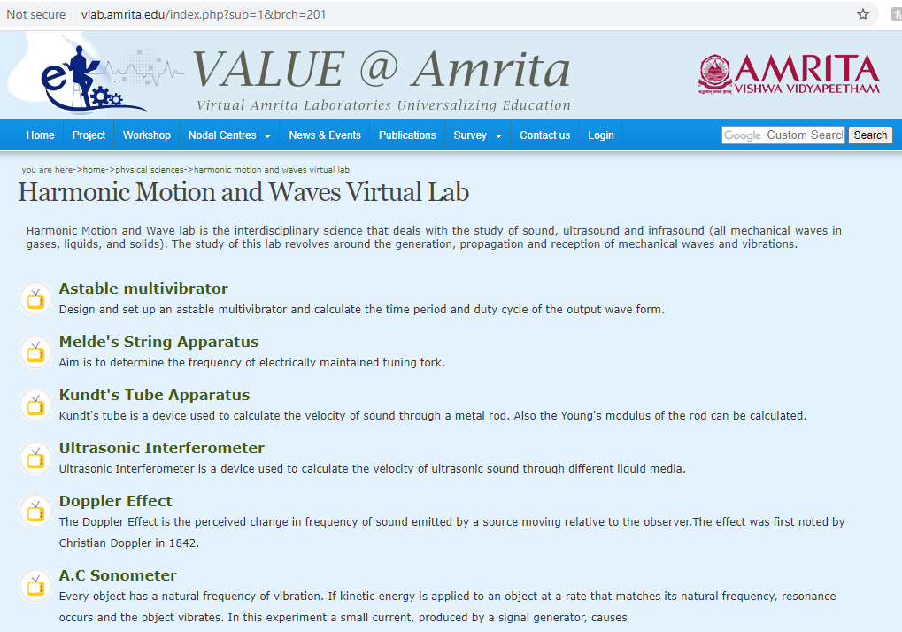
Then click on – Ultrasonic Interferometer

Slide 15
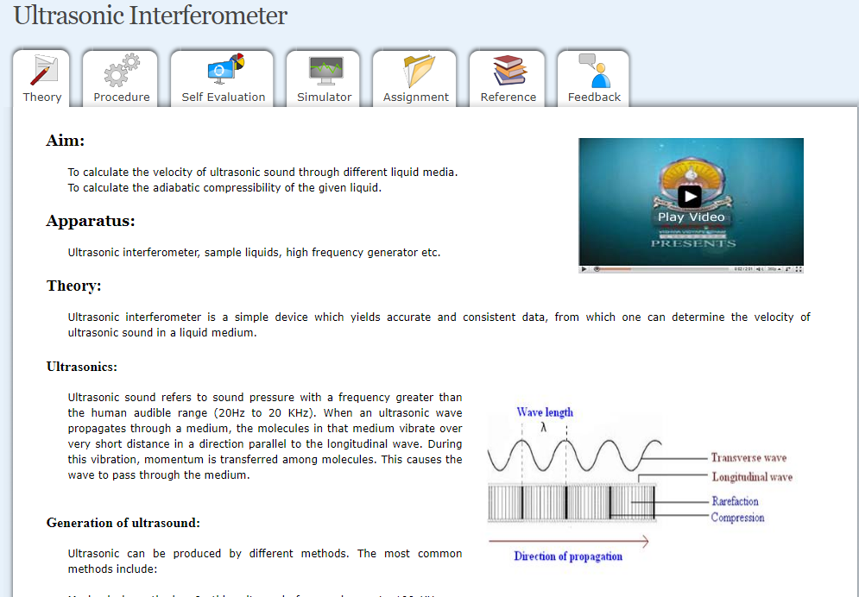
Details of the experiment will be available to you . You may login also.
Read the theory
Procedure
Complete the self evaluation to check your understanding
Then click on the simulator

Slide 16
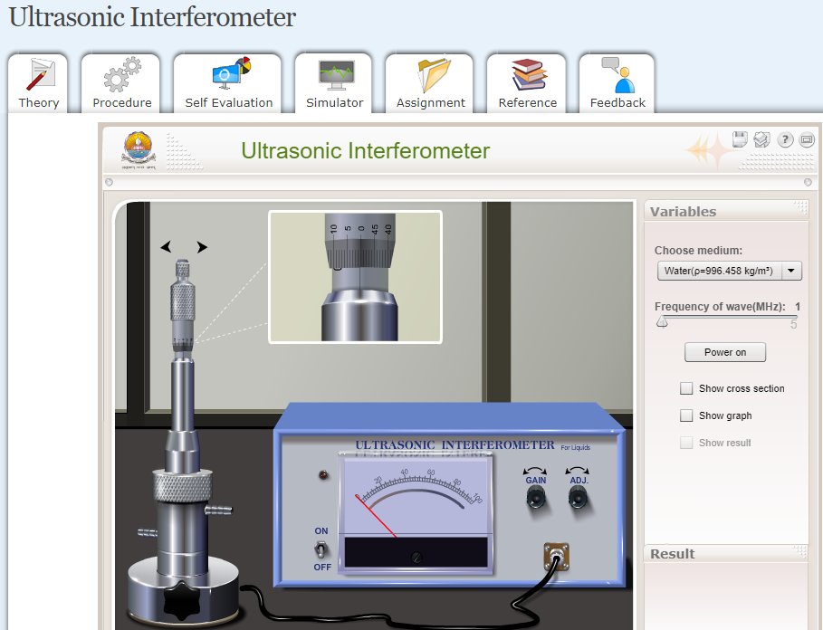
Click on the simulator
Alternative link, if adobe flash is not supported by your browser. It works in html.
http://hmw-au.vlabs.ac.in/harmonic-motion-waves/Ultrasonic_Interferometer/experiment.html

Slide 17
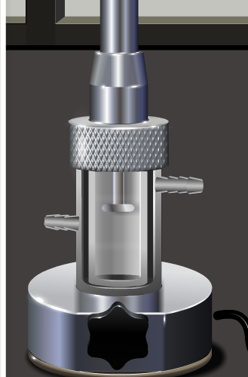
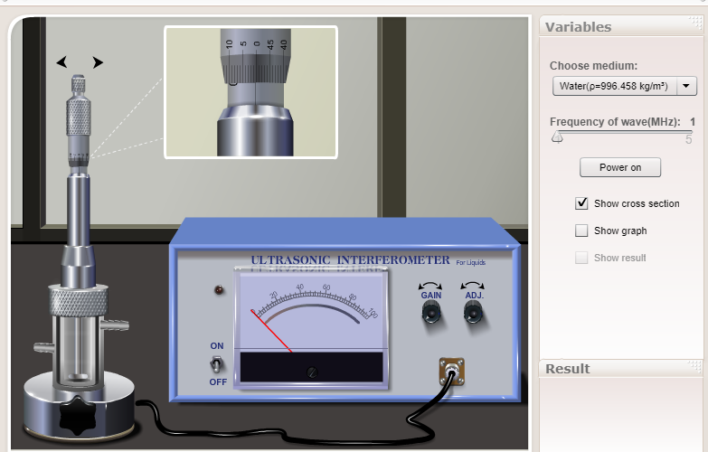
Click on the cross section icon to see the interferometer cell and switch on the frequency generator by clicking ‘Power on’ icon.
Interferometer Cell

Slide 18
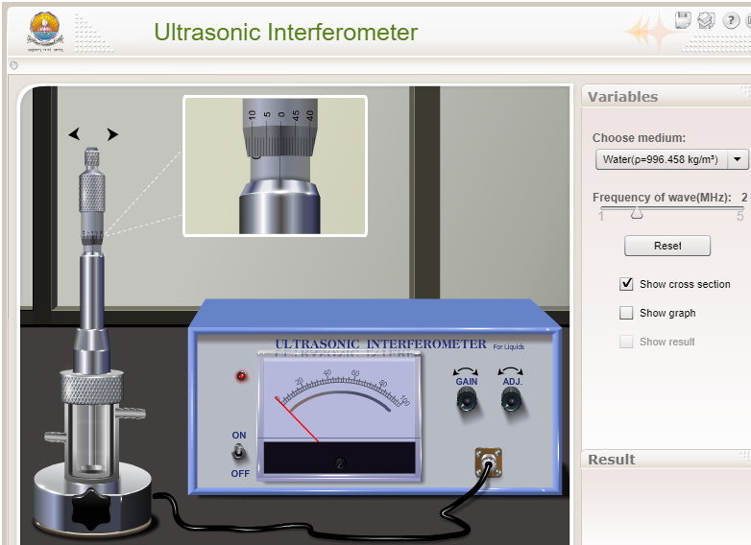
Selection of medium and frequency
Select the medium from the ‘choose medium’ drop down menu to ‘Water’.
Move the frequency sliding bar to 2 MHZ

Slide 19
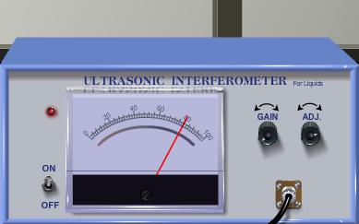
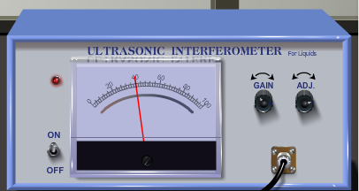
Selection of ‘Gain’ and ‘ADJ’ knob
Click here
Keep clicking the right arrow of the ‘ADJ’ knob until the ammeter reading reaches a higher value (80 in figure) from it’s ‘zero’ position.
Click here
Keep clicking the right arrow of the ‘GAIN’ knob until the ammeter reading reaches a higher value (40 in figure) from it’s ‘zero’ position. Make sure the ‘GAIN’ reading is less than that of ‘ADJ’ reading.

Slide 20
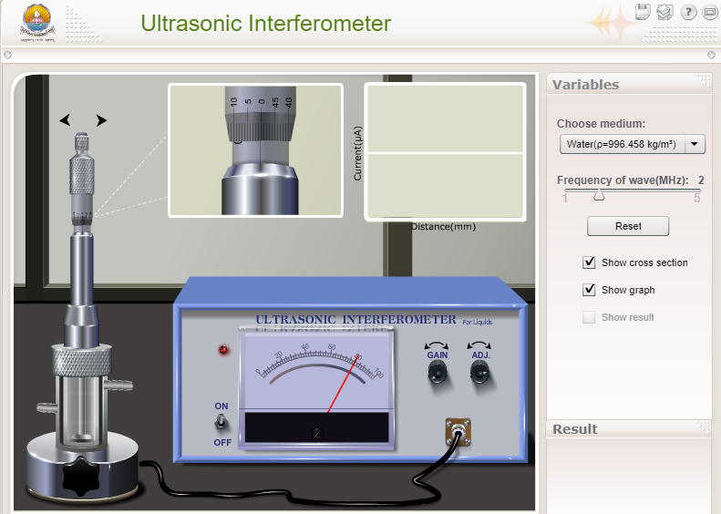
Selection of graph option
Pop-up window to observe the graph.
Click the ‘Show graph’ option to see the graph of the ammeter readings. A small pop up window will open.

Slide 21
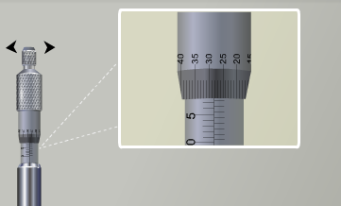
Left arrow icon
Mico-meter scale
Right arrow icon
The micro-meter scale, as shown, consists of two parts. Linear scale and circular scale, just like any screw gauge. The circular scale moves upward by clicking the right arrow icon and it moves downward by clicking the left arrow icon, as shown the figure. The least count of this scale is 0.01 mm and all readings are in mm scale.
Circular scale
Linear scale
Initially the circular scale is at the ‘zero’ position of the linear scale reading. You need to click the right arrow icon to move the circular scale upward.

Slide 22
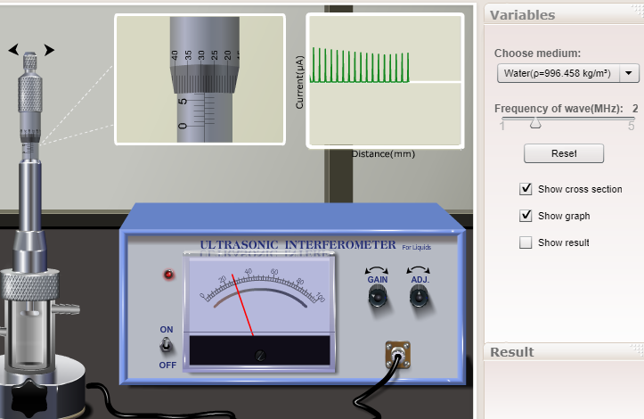
Tabulation of Micro-meter readings
In the simulator, right and left arrows are provided to move the circular scale upward and downward across the linear scale respectively. Increase the micrometer setting till the anode current in the ammeter shows a new maximum. (After the first few clicks, if you click and hold the arrow, the micrometer setting will increase continuously. A single click increases it by a small increment.) Note down the micrometer reading at the new maximum.

Slide 23
Tabulation of Micro-meter readings
Micro-meter reading= Linear scale reading + Circular scale reading X Least count
Example : Linear scale reading = 1.2 mm, Circular scale reading = 35.
Micro-meter reading = 1.2 + (35 X 0.01) = 1.55 mm
Note down the micrometer readings for each peak position of the current in the graph.
These readings are the at the current readings at each anti-nodes inside the water column and distance between two anti-nodes is half of the wavelength.

Slide 24
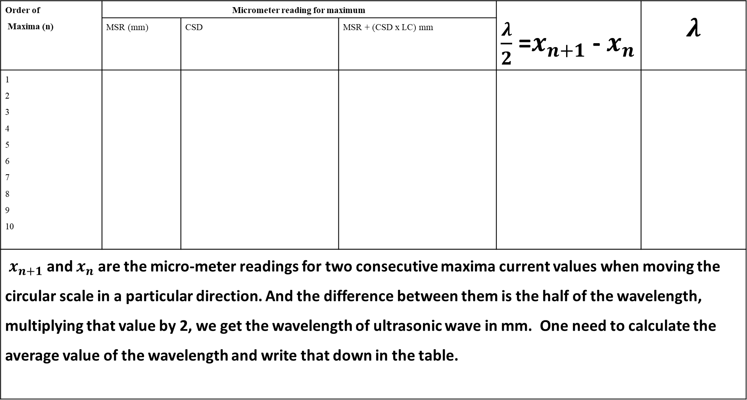
Tabulation of Micro-meter readings
Order of Maxima (n) | Micrometer reading for maximum |  |  | $\frac{λ}{2}$ =$x_{n+1}$ - $x_{n}$ | $$λ$$
 | MSR (mm) | CSD | MSR + (CSD x LC) mm
1 2 3 4 5 6 7 8 9 10
$x_{n+1}$ and $x_{n}$ are the micro-meter readings for two consecutive maxima current values when moving the circular scale in a particular direction. And the difference between them is the half of the wavelength, multiplying that value by 2, we get the wavelength of ultrasonic wave in mm. One need to calculate the average value of the wavelength and write that down in the table.

Slide 25
Necessary Formulae
Frequency of the ultrasonic wave (f)
Wavelength of the ultrasonic wave (λ)
Velocity of the ultrasonic waves in the given liquid (v) = λ × f
Compressibility =1/ρv²

Slide 26
Reading of adobe flash interface
Velocity of sound wave: 1498 m/sec

Slide 27
Reading of adobe flash interface
Velocity of sound wave: 1680 m/sec

Slide 28
Reading of adobe flash interface
Velocity of sound wave: 1472 m/sec

Slide 29
Reading of adobe flash interface
Velocity of sound wave: 1560 m/sec

Slide 30
Reading of adobe html interface
Velocity of sound wave: 1777 m/sec

Slide 31
Reading of adobe html interface
Velocity of sound wave: 1808 m/sec

Slide 32
Reading of adobe html interface
Velocity of sound wave: 2040 m/sec

Slide 33
Theory based questions

Slide 34
Theory based question
Q: 5.1 The human audible range is
20Hz - 20KHz
15KHz- 2MHz
Above 2MHz
None of the above

Slide 35
Theory based question
Q: 5.2 Ultrasonic waves have frequency is,
Less than that of human audible range
In between human audible range
Greater than the upper human audible range
None of the above

Slide 36
Theory based question
Q: 5.3 The velocity(v) of a wave is related to its wavelength(λ) by the relation,
A. v =fλ
B. f=vλ
C. v=f/λ
D. λ=vf

Slide 37
Theory based question
Q: 5.4 Among the following, which is the unit of adiabatic compressibility?
N/m²
m²/N
Kg/Nm²
None of these

Slide 38
Theory based question
Q: 5.5 Compressibility of a medium is defined as the reciprocal of
Young’s modulus Rigidity modulus Density Young’s modulus
Rigidity modulus
Density
Bulk modulus

Slide 39
Theory based question
Q: 5.6 Ultra-Sound waves are
(A) Longitudinal
(B) Transverse
(C) Electromagnetic
(D) Only magnetic

Slide 40
Theory based question
Q: 5.7 Ultra-Sound waves cannot pass through
(A) Air
(B) Vacuum
(C) Solid
(D) Liquid

Slide 41
Theory based question
Q: 5.8

Slide 42
Theory based question
Q: 5.9 In magnetostriction method,
(A) Length of an object change in presence of a magnetic field.
(B) Color of an object changes in presence of a magnetic field.
(C) Resistance of a metal becomes zero in presence of a magnetic field.
(D) A paramagnetic material becomes a ferromagnetic material in presence of a magnetic field.

Slide 43
Theory based question
Q: 5. 10 Which of the following materials could be used for the production of Ultrasonic wave,
(A) Iron
(B) Nickel
(C) Quartz Crystal
(D) All of the above

Slide 44
Theory based question
Q: 5.11 Speed of stationary waves is,
(A) 1 m s-1
(B) 2 m s-1
(C) 3 m s-1
(D) Zero

Slide 45
Theory based question
Q: 5.12 In a stationary wave, nodes are at,
(A) Fixed points
(B) Movable points
(C) There are no nodes
(D) Random points

Slide 46
Activity based questions

Slide 47
Activity based question
A: 5.1 Which liquid you used during the Experiment?
Water
Sulphuric Acid
Petrol
Mercury

Slide 48
Activity based question
A: 5.2 If you rotate the micrometer screw anti-clock wise, which direction the circler scale will move?
Upward
Downward
Right side
Left Side

Slide 49
Activity based question
A: 5.3 If you keep the ‘adj’ value less than that of ‘Gain’ Value, can you perform the experiment?
Yes
No

Slide 50
Activity based question
A: 5.4 Which parameter does get recorded in the graph when we rotate the micrometer scale?
Density of water
B. Frequency of the ultra-sonic wave
C. Ammeter reading
D. Voltage of the external power supply

Slide 51
Activity based question
A: 5.5 How many different types of liquid you can choose in this experiment?
3
4
5
7

Slide 52
Activity based question
A: 5.6 What is the range of frequency of the interferometer you can change in the simulator?
3 MHZ-10 MHz
1 MHZ- 5 MHz
1 MHz-4 MHz
3 MHz-6 MHz

Slide 53
Activity based question
A: 5.7 How do you turn on the interferometer in the simulator?
It gets automatically turned on once run.
It is not needed.
One need to click ‘Power on’ icon in the simulator.
It has to be done by your PHY 119 teacher remotely.

Slide 54
Activity based question
A: 5.8 What is the distance between two consecutive graduation on the linear scale, as available in the simulator?
0.5 mm
1 mm
1.5 mm
2 mm

